Slide 1

Minor Project on
Nepali Fake News Detection
Submitted by
Abhishek Sah [21075393]
Abhishek Shrestha [21075394]
Dibas Timalsena [21075410]
Nirmal Khatri [21075419]
Submitted to
Department of Computer and IT Engineering
Everest Engineering College
Sanepa-2, Lalitpur
Affiliated to Pokhara University
Date:12/27/2024

Slide 2
Contents
Introduction/Background
Problem Statement
Objective
Literature Review
Methodology
Evaluation/Testing
References

Slide 3
Introduction/Background
Fake news includes fabricated stories, propaganda, and misleading headlines.
Can manipulate opinions, incite violence, and undermine democracy.
Ensuring scalability to handle large datasets and real-time detection on multiple platforms.
Will account for multi-source datasets and social contexts to improve accuracy.

Slide 4
Problem Statement
With the current usage of social media platforms, consumers are creating and sharing more information than ever before, some of which are misleading with no relevance to reality.

Slide 5
Objective
To address the spread of fake news by applying machine learning algorithms with (NLP).

Slide 6
Literature Review
Soniya C. J. & Shrihari M. R. (2020). Fake news detection using AI, NLP, and ML techniques.
Objectives of Reviewed Project:
To classify online news articles as either fake or real using AI, NLP, and ML techniques.
Final Findings of Reviewed Project:
Successfully performed binary classification on various online news articles, demonstrating the potential of AI-driven solutions in fake news detection.

Slide 7
Birunda S. S., & Devi R. K. (2021). A Novel Score-Based Multi-Source Fake News Detection using Gradient Boosting Algorithm
Objectives of Reviewed Project:
To develop a score-based multi-source fake news detection system using the Gradient Boosting Algorithm.
Final Findings of Reviewed Project:
The system improved accuracy by combining information from multiple sources, making it more reliable in detecting fake news.

Slide 8
Sathyabama (2021). Fake news detection using machine learning techniques.
Objectives of Reviewed Project:
To develop a machine learning model that can effectively detect fake news.
Final Findings of Reviewed Project:
The project successfully utilized ML algorithms to detect fake news but provided limited details on model scalability and real-world application.

Slide 9
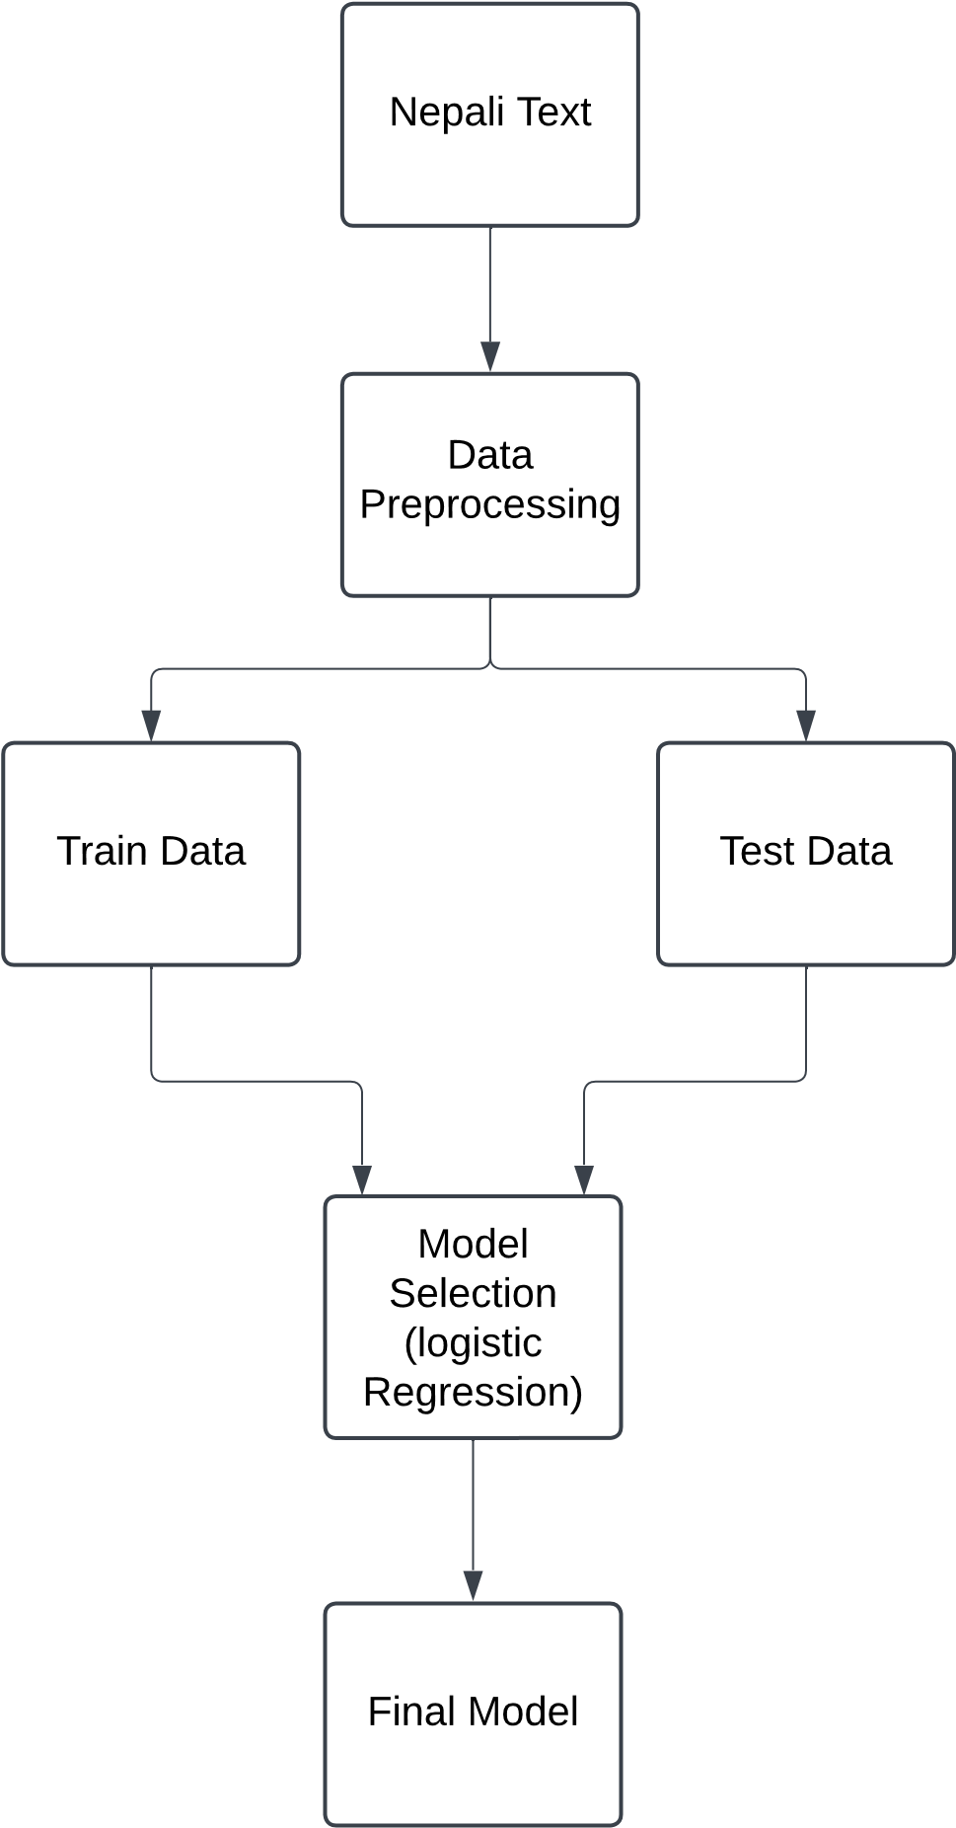
Methodology

Slide 10
Machine Learning Algorithm
Logistic regression
Mostly used in binary classification. Very effective in spam detection and fake news.
The core of Logistic Regression lies in the logistic function (sigmoid), which maps the raw prediction scores to a probability between 0 and 1.

Slide 11
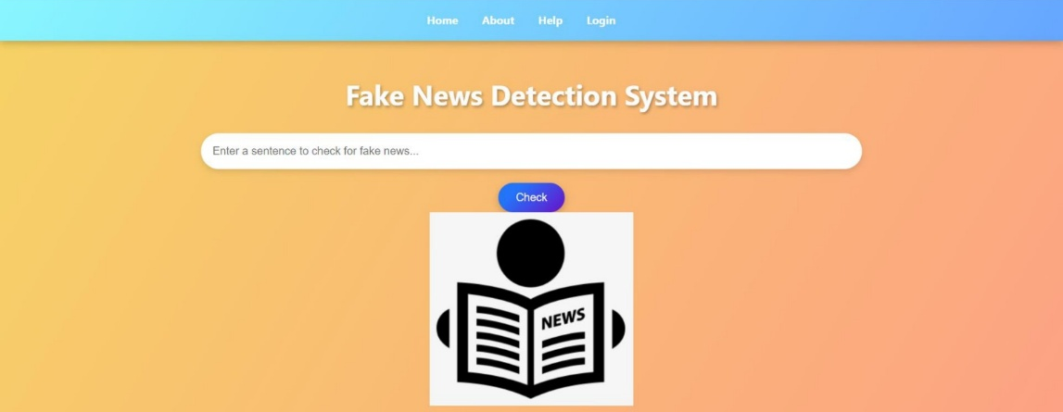
Expected Outcome

Slide 12
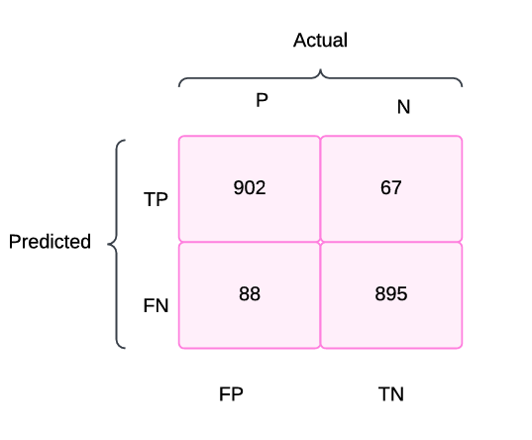
Confusion matrix of our Project

Slide 13
Work completed
Data collection
Data preprocessing and cleaning.
Model development and testing.

Slide 14
Work Remaining
Stemming.
User Interface(UI) development and connection.

Slide 15
References
[1] Soniya C J And Shrihari M R on fake news detection.
https://sjcit.ac.in/wp-content/uploads/2022/11/1SJ18CS098-soniya-cj-1.pdf
[2] Birunda S. S., & Devi R. K. (2021). A Novel Score-Based Multi-Source Fake News Detection using Gradient Boosting Algorithm.
https://sist.sathyabama.ac.in/sist_naac/documents/1.3.4/b.e-cse-batchno-214.pdf
[3] Birunda S. S., & Devi R. K. (2021). A Novel Score-Based Multi-Source Fake News Detection using Gradient Boosting Algorithm.
https://www.researchgate.net/publication/350936038_A_Novel_Score-Based_Multi-Source_Fake_News_Detection_using_Gradient_Boosting_Algorithm
[4] https://youtu.be/f7ckMaEJvh4?si=GLAYHs4qyomC67Db
[5] https://www.scribd.com/document/605810234/Fake-News-Detection-report

Slide 16
Thank You !!!

